Slide 1
CSCI-1620
Swing II

Slide 2
Events
Components can trigger an event
A single event handler can read and handle all events caused by a single frame
Creating an Event Handler
Create a nested class in the frame class that implements ActionListener
Implement
public void actionPerformed(ActionEvent event)
Determine the component that caused the event and perform the appropriate action

Slide 3
import java.awt.FlowLayout;
import java.awt.event.ActionEvent;
import java.awt.event.ActionListener;
import javax.swing.JButton;
import javax.swing.JFrame;
import javax.swing.JTextField;
public class AdditionFrame extends JFrame
{
//Fields for operand inputs
private JTextField op1;
private JTextField op2;
//Field for sum output
private JTextField sum;
//Button to perform addition
private JButton compute;
//Button to reset fields
private JButton reset;

Slide 4
public AdditionFrame()
{
super("Simple Adder");
setLayout(new FlowLayout());
//Create input fields, width of 10
op1 = new JTextField("Operand 1", 10);
add(op1);
op2 = new JTextField("Operand 2", 10);
add(op2);
//Create field for output
sum = new JTextField("Sum",10);
//User can't change text
sum.setEditable(false);
add(sum);
AdditionFrameHandler handler = new AdditionFrameHandler();
//Button to perform action
compute = new JButton("ADD");
compute.addActionListener(handler);
add(compute);
reset = new JButton("RESET");
reset.addActionListener(handler);
add(reset);
}

Slide 5
//Nested Class - Listener to handle Events
private class AdditionFrameHandler implements ActionListener
{
public void actionPerformed(ActionEvent event)
{
String out = "";
//Check which component caused the current event
if(event.getSource() == compute)
{
try{
//Get values of operands, add them and convert into String
out = String.format("%d", Integer.parseInt(op1.getText()) + Integer.parseInt(op2.getText()));
}
catch(NumberFormatException NFE)
{
//If either operand is not a valid integer
out = "ERROR";
}
//Set sum field to output String
sum.setText(out);
}
else if(event.getSource() == reset)
{
//Set text fields to their original values
op1.setText("Operator 1");
op2.setText("Operator 2");
sum.setText("Sum");
}
} //End actionPerformed
} //End AdditionFrameHandler
} //End AdditionFrame

Slide 6
import javax.swing.JFrame;
public class AdditionActionDriver
{
public static void main(String args[])
{
//Create instance of frame
AdditionFrame additionFrame = new AdditionFrame();
additionFrame.setDefaultCloseOperation(JFrame.EXIT_ON_CLOSE);
additionFrame.setSize(350, 150);
additionFrame.setVisible(true);
}
}

Slide 7
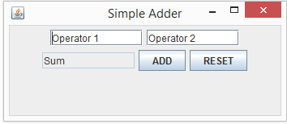
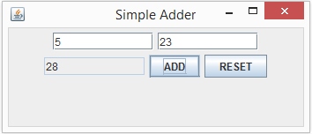
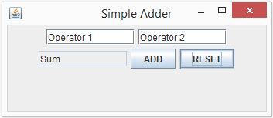

Slide 8
Flow of Events
Component triggers an Event
Components trigger Events in different ways
Text Fields trigger when Enter is pressed in the Field
Buttons trigger when pressed
Event is passed to the Listener that has been added to the component
Listener is always listening for Events
Listener determines which component triggered the current Event and performs desired action

Slide 9
Events
There are different types of Events
Different components may trigger different types of Events
Buttons and Text fields cause ActionEvents
Check Boxes and Radio Buttons cause ItemEvents
Keystrokes cause KeyEvents
A Listener is required for each type of Event that may occur
Each Listener can handle ALL events of its type
That is you only need one ActionListener to handle all components that trigger an ActionEvent

Slide 10
State Buttons
Other than the normal Action Button we have three types of buttons that maintain a state
JToggleButton
Looks like a normal button but maintains a state of pressed or not pressed
JCheckBox
Can be selected or unselected
JRadioButton
Can be selected or unselected, normally appear in a group in which only one will be selected at one time

Slide 11
State Buttons
State Buttons have an on/off or true/false values
State Buttons cause an ItemEvent when their state is changed
This requires an ItemListener to handle their events
Like ActionListener there is an ItemListener interface that can be implemented by a nested class
This ItemListener can handle all State Buttons that are present

Slide 12
import java.awt.FlowLayout;
import java.awt.event.ItemListener;
import java.awt.event.ItemEvent;
import javax.swing.JCheckBox;
import javax.swing.JFrame;
import javax.swing.JTextField;
public class CheckBoxFrame extends JFrame
{
private JCheckBox check;
private JTextField outField;
public CheckBoxFrame()
{
super("Check Test");
setLayout(new FlowLayout());
//Create components
check = new JCheckBox("Check Me");
outField = new JTextField("Not Selected");
outField.setEditable(false);
//add components to frame
add(check);
add(outField);
//add ItemListener to check box
check.addItemListener(new CheckListener());
}

Slide 13
private class CheckListener implements ItemListener
{
public void itemStateChanged(ItemEvent event)
{
String outputText = "";
//See if check box is selected
if(check.isSelected())
{
outputText = "Selected";
}
else
{
outputText = "Not Selected";
}
outField.setText(outputText);
} //End ofitemStateChanged
} //End of CheckListener class
} //End of CheckBoxFrame
*Note that the method implemented for an ItemListener is itemStateChanged(ItemEvent event), not actionPerformed(ActionEvent event) like with the ActionListener

Slide 14
import javax.swing.JFrame;
public class CheckDriver {
public static void main(String[] args)
{
CheckBoxFrame checkFrame = new CheckBoxFrame();
checkFrame.setDefaultCloseOperation(JFrame.EXIT_ON_CLOSE);
checkFrame.setSize(300, 100);
checkFrame.setVisible(true);
}
}

Slide 15
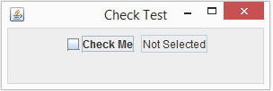
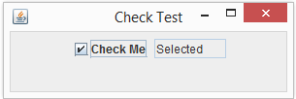

Slide 16
import java.awt.FlowLayout;
import java.awt.event.ItemEvent;
import java.awt.event.ItemListener;
import javax.swing.ButtonGroup;
import javax.swing.JFrame;
import javax.swing.JRadioButton;
import javax.swing.JTextField;
public class RadioButtonFrame extends JFrame
{
private JRadioButton button1;
private JRadioButton button2;
private JRadioButton button3;
private ButtonGroup radioGroup;
private JTextField outField;
ButtonGroup is used to logically associate buttons. In the case of radio buttons it will ensure that only one is active at any time. ButtonGroup itself is not a component that is added to the frame, the individual buttons will still be added as components.

Slide 17
public RadioButtonFrame()
{
super("Radio Test");
setLayout(new FlowLayout());
outField = new JTextField("Button 1 On");
outField.setEditable(false);
add(outField);
//Create radio buttons, set starting values so one is selected (true)
button1 = new JRadioButton("Button 1", true);
button2 = new JRadioButton("Button 2", false);
button3 = new JRadioButton("Button 3", false);
add(button1);
add(button2);
add(button3);
//Create ButtonGroup and add buttons to the group,
//creates a logical association between buttons
radioGroup = new ButtonGroup();
radioGroup.add(button1);
radioGroup.add(button2);
radioGroup.add(button3);
//Creat Listener and add to buttons
RadioListener handler = new RadioListener();
button1.addItemListener(handler);
button2.addItemListener(handler);
button3.addItemListener(handler);
}

Slide 18
private class RadioListener implements ItemListener
{
public void itemStateChanged(ItemEvent event)
{
String outputText = “”;
//Set output text based on button that was pressed
if(event.getSource() == button1)
outputText = "Button 1 On";
else if(event.getSource() == button2)
outputText = "Button 2 On";
else
outputText = "Button 3 On";
//Set the text field to active button's text
outField.setText(outputText);
} //End itemStateChanged
} //End RadioListener class
} //End RadioButtonFrame

Slide 19
import javax.swing.JFrame;
public class RadioDriver
{
public static void main(String[] args)
{
RadioButtonFrame radioFrame = new RadioButtonFrame();
radioFrame.setDefaultCloseOperation(JFrame.EXIT_ON_CLOSE);
radioFrame.setSize(400, 100);
radioFrame.setVisible(true);
}
}

Slide 20
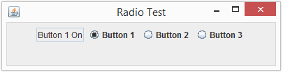
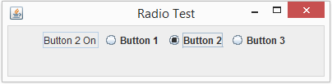
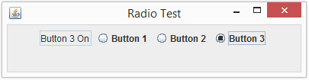

Slide 21
import java.awt.FlowLayout;
import java.awt.event.ItemEvent;
import java.awt.event.ItemListener;
import javax.swing.JComboBox;
import javax.swing.JFrame;
import javax.swing.JTextField;
public class ComboBoxFrame extends JFrame
{
//JComboBox uses a generic type, we want to populate
//it with Strings
private JComboBox<String> comboBox;
private JTextField outField;
//Array of Strings that will be the possible choices in combo box
private String[] choices = {"Selection 1", "Selection 2", "Selection 3"};
public ComboBoxFrame()
{
super("Combo Box Test");
setLayout(new FlowLayout());
//Set up output field, starts with default selection
outField = new JTextField("Selection 1");
outField.setEditable(false);
add(outField);
//Create JComboBox, give array of Strings for choices
comboBox = new JComboBox<String>(choices);
//Set number of rows in box to number of choices
comboBox.setMaximumRowCount(3);
comboBox.addItemListener(new ComboListener());
add(comboBox);
}

Slide 22
private class ComboListener implements ItemListener
{
public void itemStateChanged(ItemEvent event)
{
//Was the event caused by changing the choice in box?
if(event.getStateChange() == ItemEvent.SELECTED)
{
//getSelectedIndex returns an int corresponding to
//the item selected, 0 based indexing
//Set the output text to the correlating String in
//the array of Strings
outField.setText(choices[comboBox.getSelectedIndex()]);
}
} //End iteStateChanged
} //End ComboListener
} //End ComboBoxFrame

Slide 23
import javax.swing.JFrame;
public class ComboBoxDriver {
public static void main(String[] args)
{
ComboBoxFrame comboFrame = new ComboBoxFrame();
comboFrame.setDefaultCloseOperation(JFrame.EXIT_ON_CLOSE);
comboFrame.setSize(250, 100);
comboFrame.setVisible(true);
}
}

Slide 24
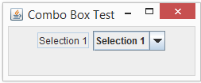
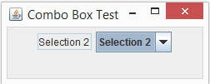
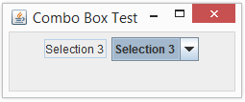

Slide 25
Event Handling
Most of these examples only used one alterable component at a time
Typically a single frame will have multiple components
Remember, you need a Listener for each type of Event that could occur
Many Events of a single type can be handled by a single Listener of that type
Use the Event’s getSource() method to determine which component triggered the Event

